Slide 1


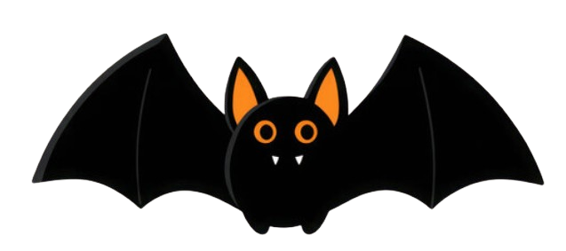
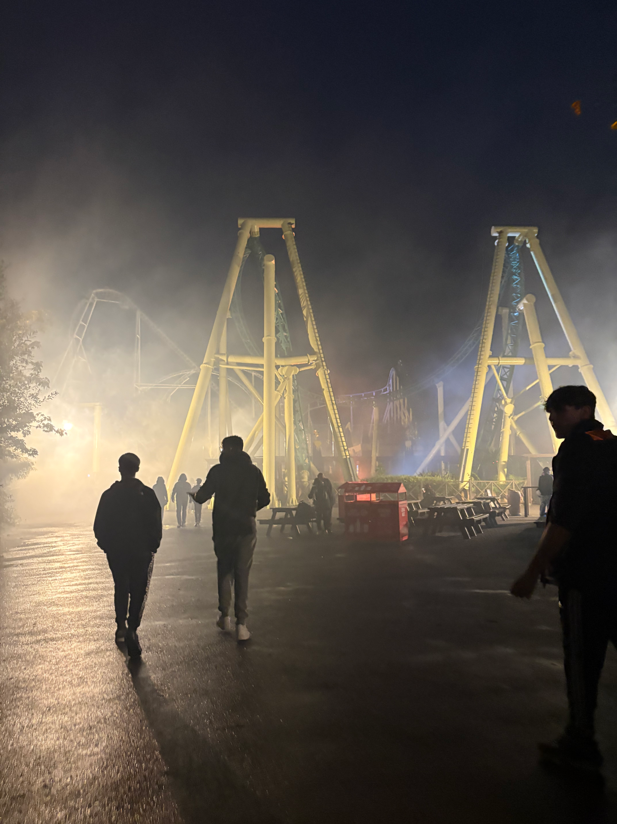
Halloween mini edition
Park Life
6th Edition
there will always be a bit of my heart devoted to it
Frightfully Fun
A spooktacular time at Thorpe Park
By Laila Haines
The sixth form enjoyed a tour of terror on their annual outing to the Thorpe Park Fright Night.
The event was so popular that it had to be split into two visits with half the sixth form visiting on Friday 17th, whilst the second group went on Monday 20th of October.
Startled students got to choose between four ´scare zones' including The Crows of Mawkin Meadow and the cheerfully named Purgatory Town to test their mettle against the frights the venue had to offer.
The park, based in Chertsey, Surrey, is well known for a host of hair raising extreme rides such as The Swarm and Hyperia and, despite protesting that she 'didn't want to go upside down', Ms Tregear, one of the accompanying staff, was spotted on Colossus - a ride with 10 loop the loops – twice.
Year 13 student, Izzy, said it was a really fun night.
“I loved the rides. It was so much fun! The rides were brilliant, the KFC was brilliant and being able to do it with
my friends was just brilliant!”
Another year 13 student said that it was a great way of celebrating the completion of the first term.
“Thorpe Park was an amazing experience,” she said. “There was so much laughter as well as screaming! I’m sure the year twelves are already looking forward to going again next year.”
Mr Wickes gave the trip a rating of 12 out of 10.
.

Slide 2


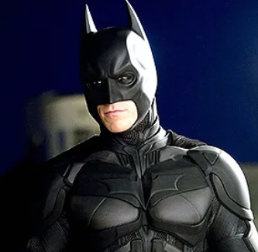
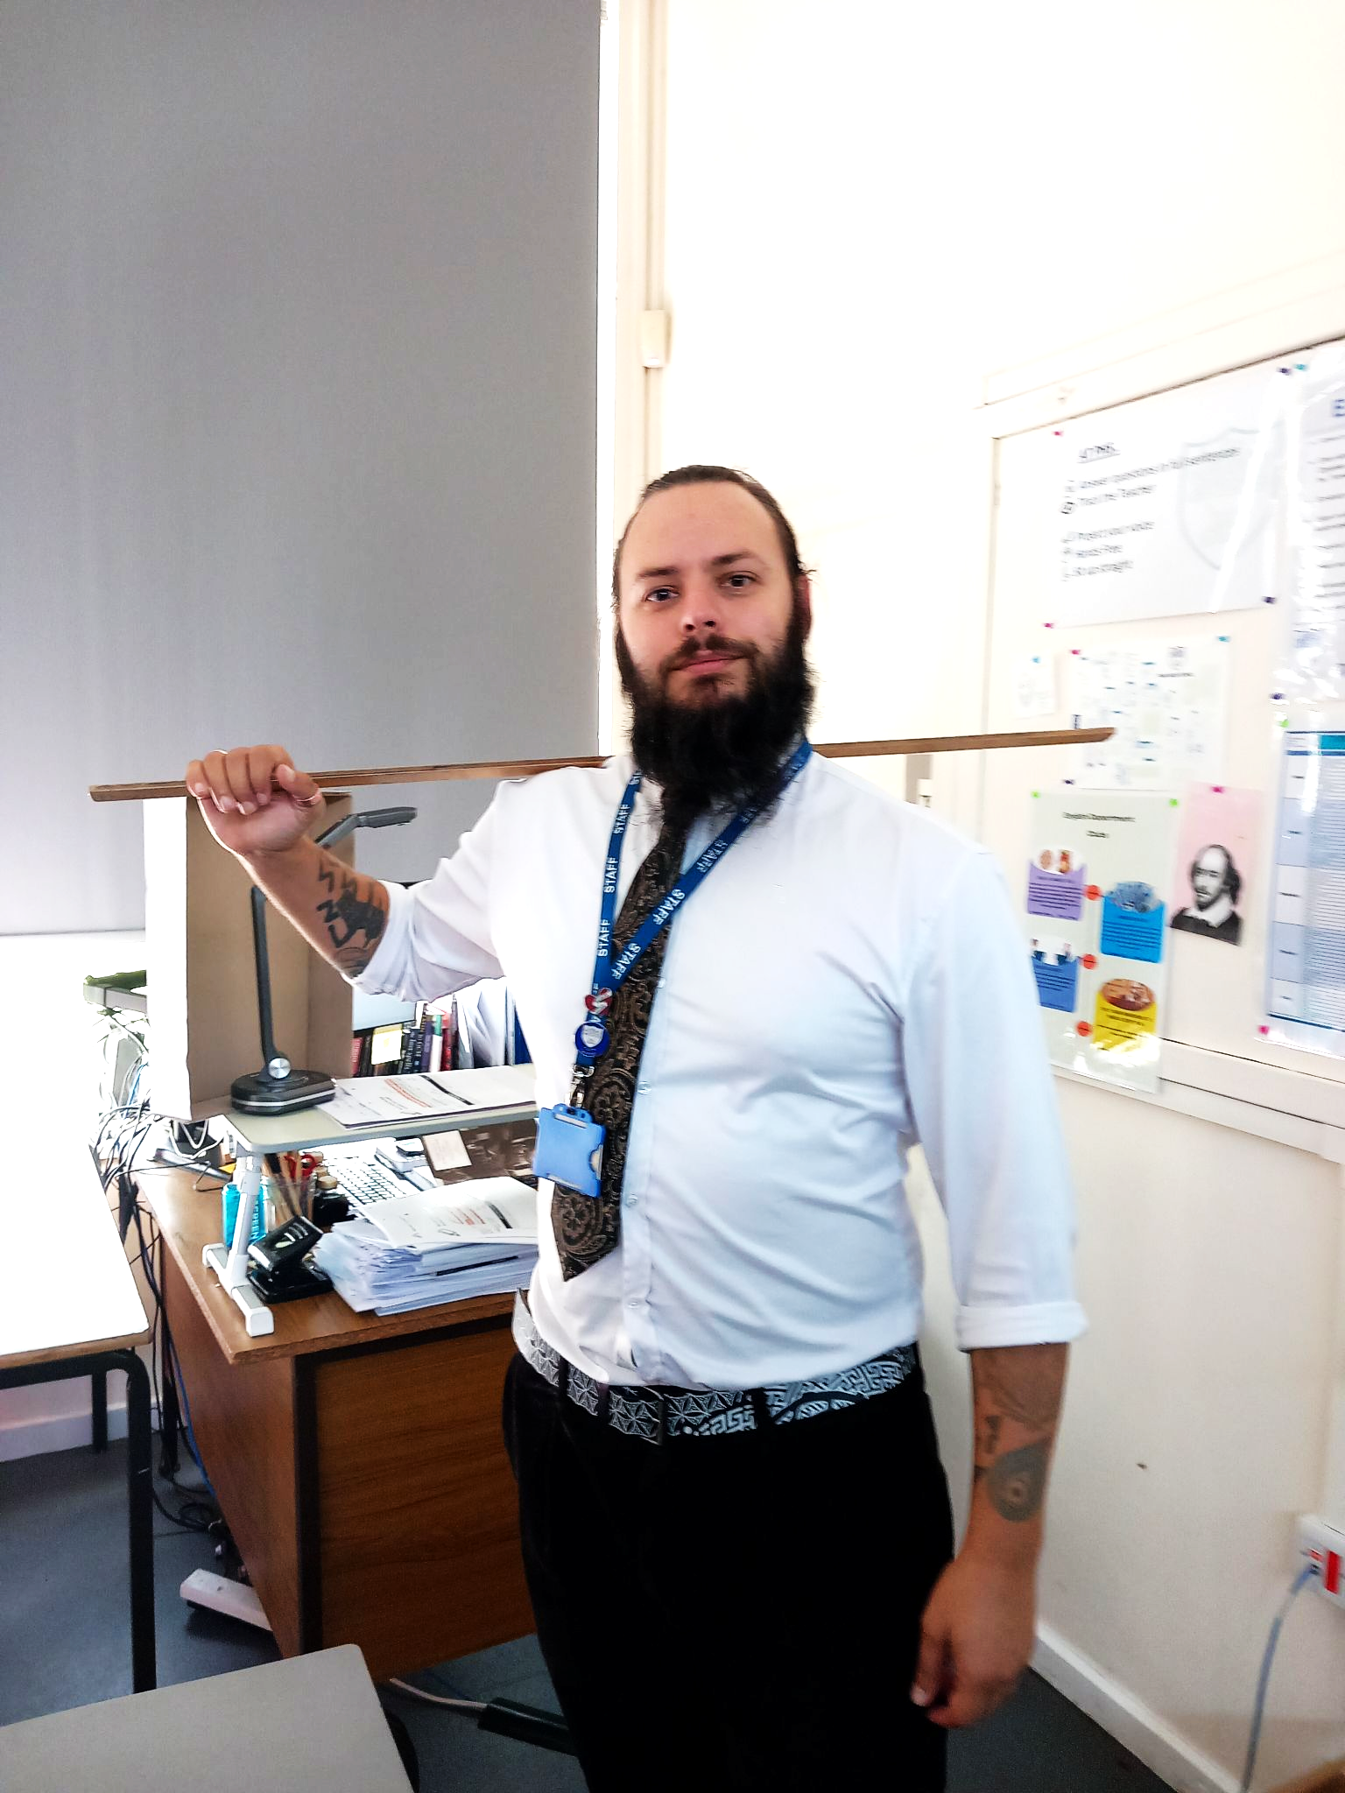
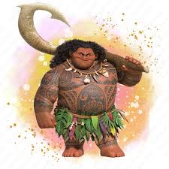
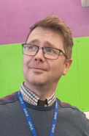
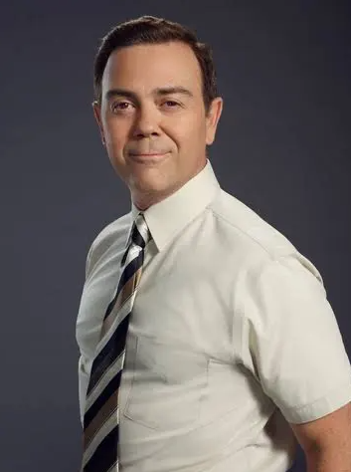
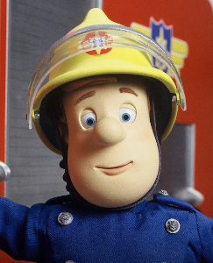
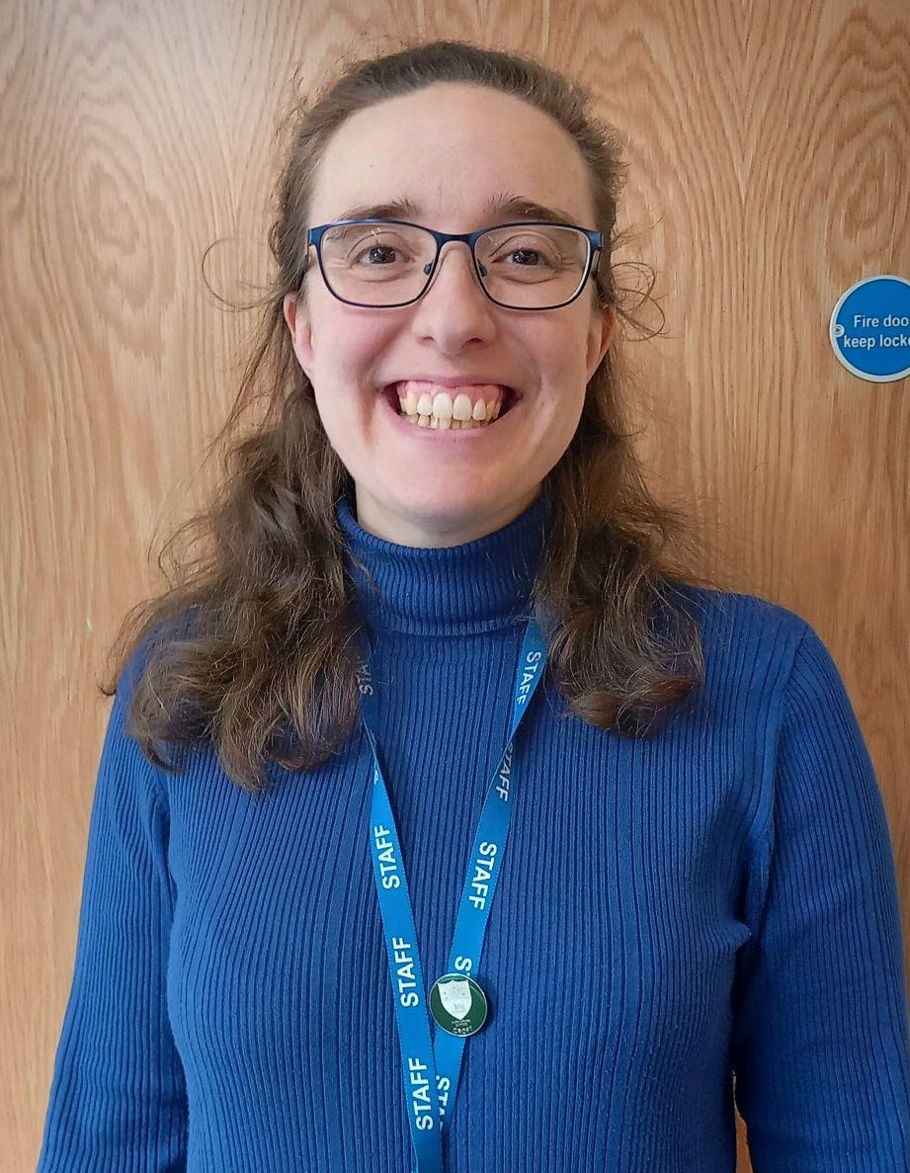
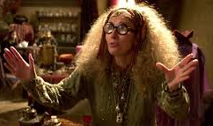
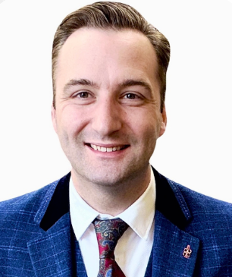
Celebrity lookalikes
Written by Sofia Hipsey Santana
Teacher twins
They might be stars in their own classrooms but we think some of our teachers look like real stars of stage and screen. Take a look at the following selection and see if you agree! (We´ve labelled them so you can tell them apart)
The man behind the mask: Mr Carolan and Batman.
You´re welcome: Mr Gianakakis and Maui.
To the rescue: Mr Phillips and Charles Boyle
An eye on the future: Dr Yates and Professor Trelawney
Ready for action: fireman Sam and Mr Marshall.

Slide 3
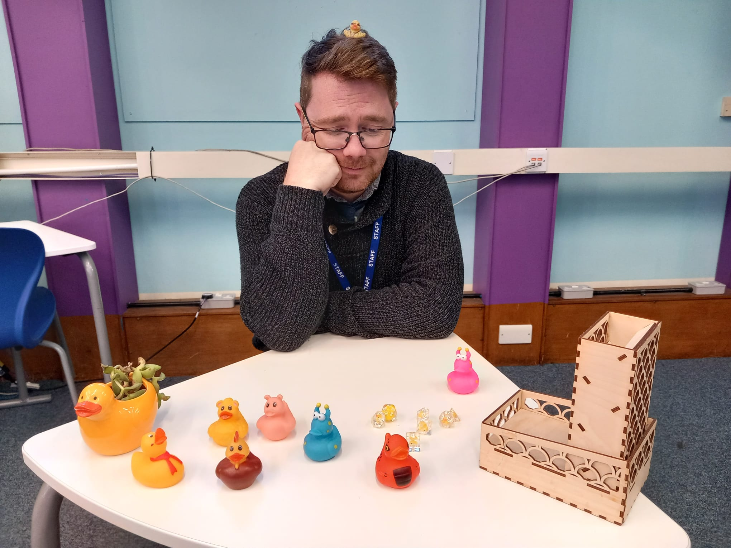
Duck Tales
Written by staff writer
teacher talk
Mr Phillips, head of Computer Science and director of all things duck, claims there is a very rational explanation for all his floaty friends.
“They actually help with debugging,” he says. “Sometimes you just need to slow down and think rationally and explaining your code to a unjudgmental, impartial third party - such as a rubber duck - really helps you work through your steps and find the issue.”
Things did get slightly quacked when one sixth form student decided to hide over a hundred tiny plastic ducks around the room, however Mr Phillips thinks he may have found the majority of them.
“They do seem to capture the imagination,” he explains. “I don't think I actually bought that many of them in but they seem to turn up by themselves and make themselves at home.
“I do really enjoy watching my computer scientists all explaining themselves to ducks though, that's definitely one of the more enjoyable moments of my teaching day.”
So if you find yourself in homework club or class being spectated upon by the waterborne watchers, don´t let it ruffle your feathers - they´re here to help you quack on.
They say that birds of feather flock together: a gaggle of geese, a quarrel of sparrows and the worryingly named murder of crows. But visitors to the CR1 might be left scratching their heads as to what to call the avian invasion taking place in the computer room considering they’re all various varieties of rubber duck.
The ducks, which decorate an entire desk as well as wall posts and the top of the white board, come in a range of colours and materials with some even serving different roles such as plant pots.

Slide 4
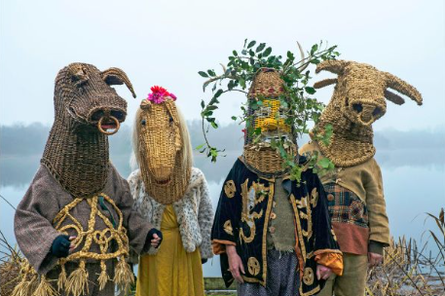
Samhain
Written by Mr Gianakakis
Halloween history
In times gone by the grotesque and ghoulish jack-o’-lantern (originally carved from turnips, rather than pumpkins!) was to ward off evil spirits and Death themself, rather than plastic-masked ghouls with a sugar addiction. Its name, Samhain (pronounced SOW-ayn). A time for giving thanks for what the bountiful earth had granted, and accepting the darker, colder half of the year. It was at this time the veil between worlds was said to be at its thinnest, and rituals to honour the dead and connect with the spirit world took place. A time to honour your ancestors. To reflect.
As Christianity rose in popularity, All Saints’ Day, also known as All Hallows Day (Can you see where I’m going with this?) was moved to be celebrated on November 1st Naturally, those following the Celtic ways still celebrated Samhain on October 31st, which soon took on a new name. All Hallows Evening. It wasn’t too long before that was shortened to Hallowe’en, then later Halloween.
Ok, but why do we now gorge ourselves into a sugar-coma every year? Turns out, adolescents and apparitions have something in common. You see, initially, people would leave offerings outside their homes for the spirits as a means of appeasing them, keeping them sweet - I’ve punned there, and I’m not sorry. As society has changed, and people began to believe less and less that they might be visited by their ancestors in spirit form, they now seek to treat visitors to avoid a trick being played on them. And whilst it may seem appealing to don a ghostly mask and terrorise your neighbours procuring some delicious treats, perhaps we should look to those that have come before. Reflecting on what we have accomplished so far this year, and looking ahead.
Can you feel it? The chill in the air? The breeze blushing cheeks as it seems to slice through your very bones? Winter is making her presence known, and how do we respond? Bonfires, the merriment of friends, of family, and Pumpkin Spice Lattes. This has always been the way (sans Pumpkin Spice Lattes). Since humankind first started to understand the cycle of the year, they knew that this was the time that death seemed to grip the land. Trees began shedding their leaves, flowers withered, harsher conditions saw the loss of family and friends alike. Kin.

Slide 5
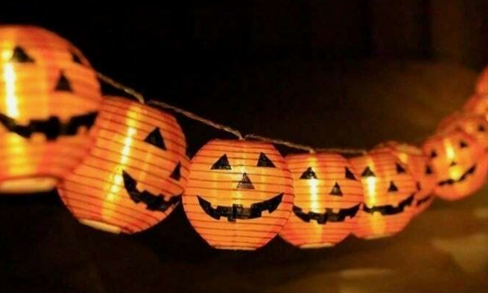
Monstrous fun
Written by Erin Wallace and Tess Martin
Short Story
She was asking too many questions, so I decided to come clean. I needed to get back to school. There was no other choice.
“I was born with them and-”
She laughed.
“No seriously. I need to get back to my school.”
“The last thing I’d want to be doing is going to school on halloween!” She exclaimed, grabbing my hand and starting to walk down the street. She brought me over to a door.
“Come on,” She said “Let’s trick or treat together! It’s not like I have friends to do it with anyway.”
“Oh, I don’t know…” But it was too late. Luna had already dragged me onto someone's porch and rang the doorbell. The people were nice, and I liked this less chaotic version of halloween. As the night went on, I became less worried about getting back to school. I mean, this was amazing.
“Luna, this has been great. Well, except falling from the sky.” I laughed.
“ You could stay here? I know that you need to get back to your school and all, but you seem happier here.” It was dark out by now, no one else was on the road.
“Maybe. But what would people think of my fangs? They’d definitely notice.”
“Well, maybe you shouldn’t hide them anymore! Your school has taught you to do that for years! But is that really what you want?” Luna stopped walking.
“Of course not!” I said, standing tall, but inside I was on the verge of tears. I’d never thought to myself what I wanted. And Luna was right. I can’t hide anymore.
“Yes. I've realised today, I love this place. You're free to do whatever you want!”
So, I stayed with Luna. One month turned into a year, one year turned into a lifetime.
Halloween is the biggest event in my “monster school" and they went crazy with the decorations this year. Pumpkin string lights, countless numbers of fake doors (the school always wants us to feel connected with“normal children” but they can’t see our real identity). So for halloween, they made the main hall into a “haunted street”.
I walked over to the corner where the bookshelf sits. It was covered with a flowing curtain.
No one was around. Some people think the bookshelf is haunted so they don't go near it.
I reached for a book and suddenly, the lower part of the bookshelf opened up.
I fell back in amazement. It had an opening. I reached inside, hoping to find some extra books that could patch it up. I leaned forward, but then I fell.
I just kept falling. A scream escaped my lips as I hit the concrete floor.
“Ouch!” I clutched my bleeding head, looking around at what looked like a street. Could it be… A real street?
Real people?
Real world.
I couldn’t believe it.
A tall girl, around my age, came up to me. We were the complete opposite of each other.
“I might have had too much sugar, but did you just fall from the sky?” She giggled, helping me up. I stumbled.
“Maybe.” I said, looking at her. She was alone, no friends, no family, no one. Which I thought was odd.
“ What’s your name?” I asked, still absorbing the atmosphere around me.
“Luna. You?”
I didn’t know what to say, but she couldn’t find out about me.
“Cool fangs by the way. Where’d you get them?”

Slide 6
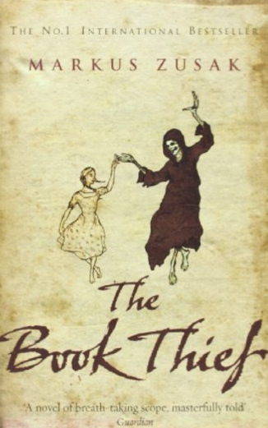
The Book Thief
Review by Elianne Swingler
Book review
Liesel steals books to help her deal with the trauma. This is her story and the story of the inhabitants of her street when the bombs begin to fall…
Although the novel follows the Death’s narration is both chilling and compassionate, offering a unique perspective that makes the story unforgettable. The novel explores themes of mortality, the power of words, and the resilience of the human spirit.
Despite being born in Australia, the author, Markus Zusak was inspired to write the book after hearing stories told by his German and Austrian parents who shared their tales of growing up in their home countries during World War II.
It was a great book but it is quite intense and may be a bit emotional. The one word I can use to describe it is heartbreaking. There is so much death, personal pain and flat out injustice and cruelty but mixed with a dark humour it doesn't become depressing. One of the things that may be quite sad is the amount of death and topics of the war and other sensitive subjects. It is quite gruesome, so once again, it’s very interesting but reader discretion is advised.
The year is 1939 and Germany is under the threatening reign of the Nazi´s. While the country is holding its breath, death has never been busier. Leisel, a nine-year-old, is living with a foster family on Himmel Street. Her parents have been taken away to a concentration camp.

Slide 7
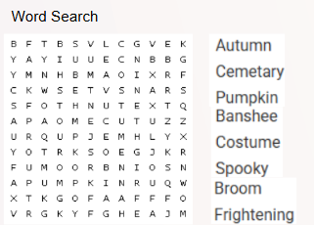
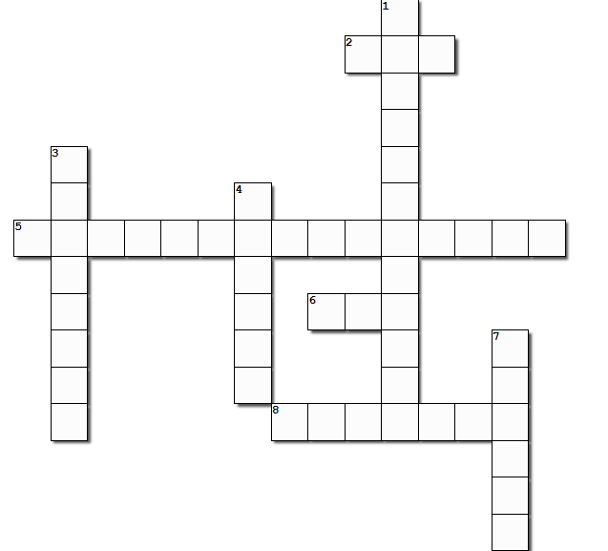
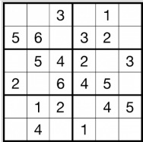
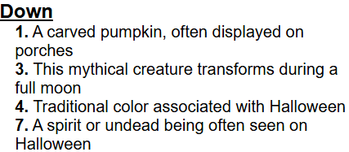
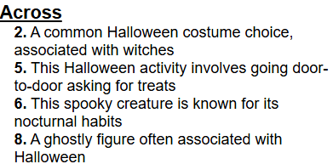
Pictures and Puzzles
Crossword
Sudoku
Newspaper Credits:
Sofia Hipsey Santana
Eila Suggitt
Elianne Swingler
Lara Vargas Meyer
Amelie Walsh
Laila Haines

